Slide 1


Payments to governments data and resourceprojects.org
Notes:
Introduction
From the governance team at NRGI based in London
Shared the importance of managing the revenues you receive from extractives in Ghana – this session will go into how you can add data to stories to communicate to your audience how much the government receives from its oil and gas and mining to put pressure on government entities to manage these revenues well
Aim is to make your life easier – add data in a way that can instantly add a hook, important and new piece of news to your stories
Presentation on New revenue data source, how this new data source can add to stories in Ghana and how NRGI can support journalists in adding this data to their stories

Slide 2
Overview
Introduce payments to governments data
Outline NRGI use cases for payments to governments data and resourceprojects.org
Demonstrate features of resourceprojects.org
Outline planned new features for resourceprojects.org
Notes:
Overview of Mandatory disclosure laws and payments to governments data
What companies disclose in Ghana – both oil and gas and mining
How this data can be relevant to ongoing stories in Ghana
How NRGI has supported journalists in using this data

Slide 3
Mandatory disclosure laws - Overview
US: Dodd Frank 1504
Canada ESTMA
G8 commitment June 2013
Switzerland (draft law this week) / Ukraine…
Passed December 2013; in force January 2014
Norwegian Regulation on Country By Country Reporting
EU Accounting and Transparency Directives
Passed mid-2013; 28 EU countries had to transpose (implement) by mid-2015
Payment disclosure by US-listed oil, gas, and mining companies at project level
Consistent with 1504; also includes large private companies and logging companies / Approx. 150 companies
Extractive Sector Transparency Measures Act (private and listed companies)
Legislation Dec 2014; in force June 2015
Consistent with 1504/EU Directives
Goes further: all subsidiaries, revenue, cost, investments
Australia – Labour Party commitment. General election?
BRICS/MINT and other major economies?
Passed June 2010; initial 2012 SEC rules vacated, 2016 rules disapproved
Approximately 400 reports
Going global…?
New rules due by Feb 2018; also repeal Bill in Congress
Notes:
– Come about due to laws in EU Canada and Norway that require companies to disclose the payments they make to governments for the extraction of oil and gas and minerals
- They are required to disclose any payment over 100,000
They have to report which specific government entity has received the revenue
Subnational entities – such as district assemblies
SOEs GNPC
They must also disclose at project-level
Must disclose payment type – i.e. royalty or dividend
Have to disclose within 150 days of end of financial year – makes this very timely. All for 2017 compared to 2015 for GEITI
Key features
Payment types:
(a) production entitlements;
(b) taxes levied on the income, production or profits of companies, excluding taxes levied on consumption such as value added taxes, personal income taxes or sales taxes;
(c) royalties;
(d) dividends;
(e) signature, discovery and production bonuses;
(f) licence fees, rental fees, entry fees and other considerations for licences and /or concessions; and
(g) payments for infrastructure improvements.

Slide 4
What is in the data?
Summary of Mandatory Disclosure laws
What companies must disclose? | Oil, gas or mining companies incorporated or listed on a regulated stock exchange in Canada, Norway or any EU Member State.
What are they required to disclose? | Payments made to governments, including state owned enterprises, in relation to extractive activities. Payments should be attributed to projects where applicable.
What types of payments must they disclose? | 1. Production entitlements 2. Taxes 3. Royalties 4. Dividends | 5. Signature, discovery and production bonuses 6. Licence Fees 7. Payments for infrastructure improvements
What is the payment threshold? | Single, or series of, payments that amount to EUR100,000 in the EU/EEA or CAD100,000 in Canada.
When do they have to disclose? | Companies have 150 days after the end of their financial year to file their Payments to Governments Report.
Notes:
Company disclosure – this is the company statement – can be used in conversation in government
Timely, important to having story relevant to audience – GEITI most recent report from 2015 – hard to gain attention of audience as much
Payment types – Every company must use same definition – and we will look at what times of payments we should expect

Slide 5
Uses For Payments To Governments Data Within NRGI

Slide 6
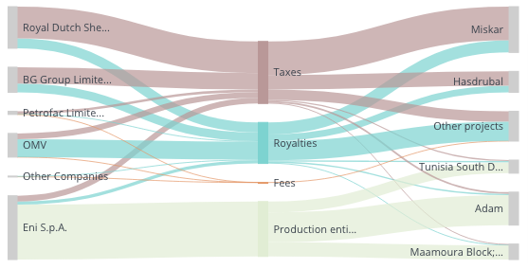
NRGI Priority Country Payment To Government Data: MENA
Tunisia
638 million USD in payments
6 reporting companies

Slide 7
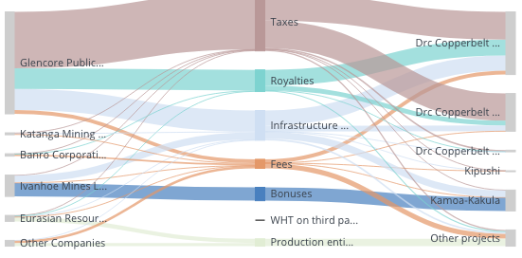
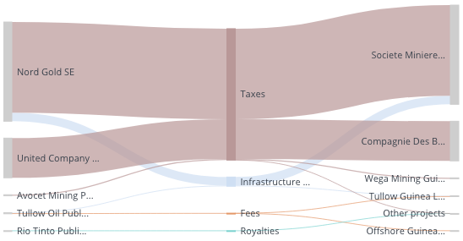
NRGI Priority Country Payment To Government Data: Francophone Africa
Democratic Republic of Congo
1.1 billion USD in payments
12 reporting companies
Guinea
38 million USD in payments
6 reporting companies

Slide 8
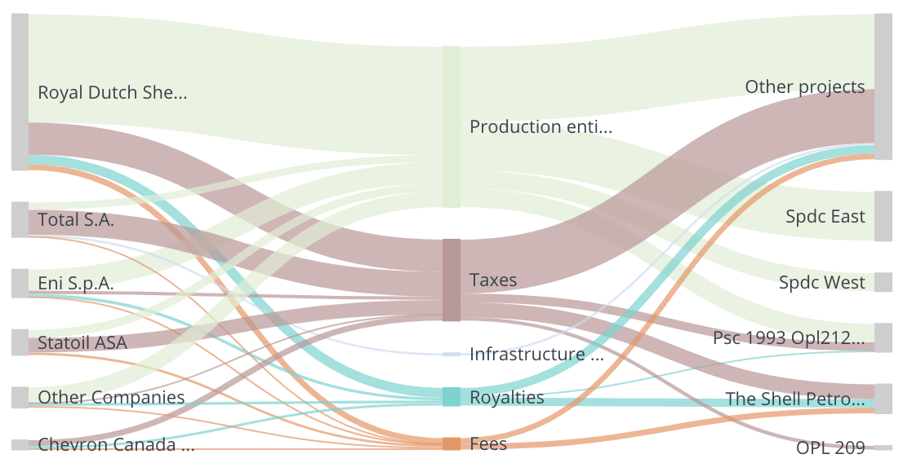
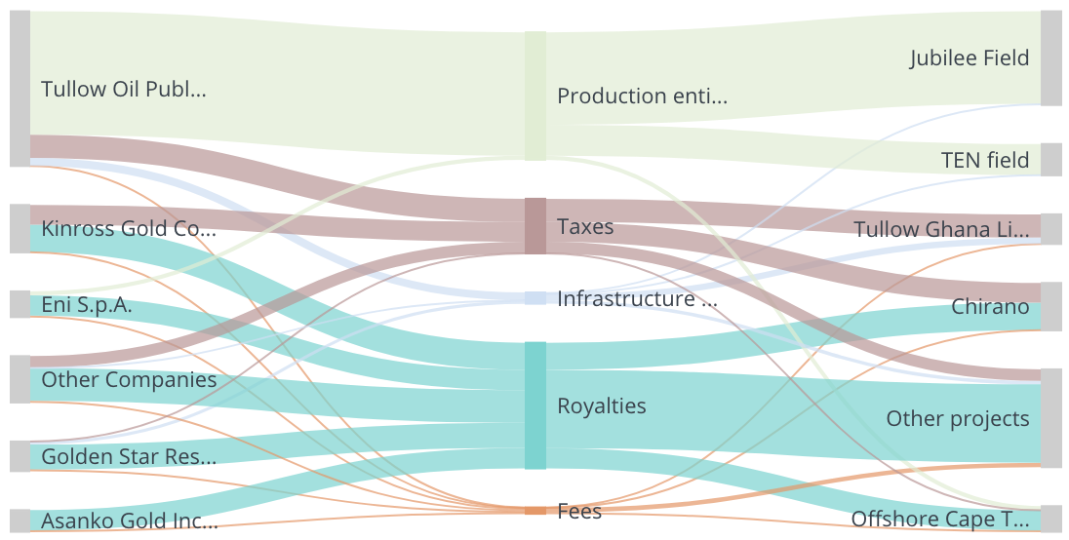
NRGI Priority Country Payment To Government Data: Anglophone Africa
Nigeria
22.6 billion USD in payments
10 reporting companies
Ghana
383 million USD in payments
11 reporting companies

Slide 9
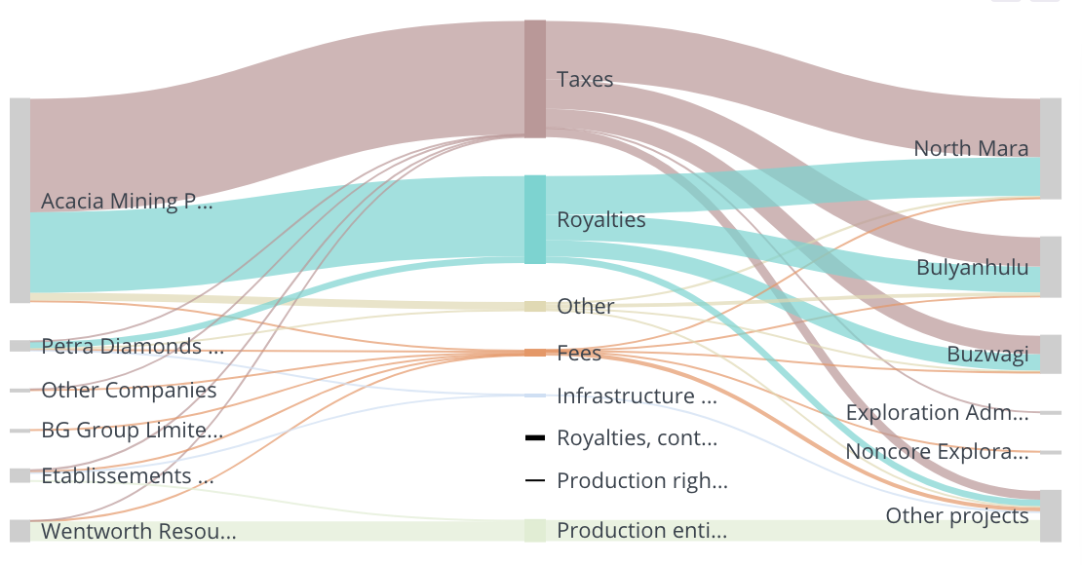
NRGI Priority Country Payment To Government Data: Anglophone Africa
Tanzania
258 million USD in payments
13 reporting companies

Slide 10
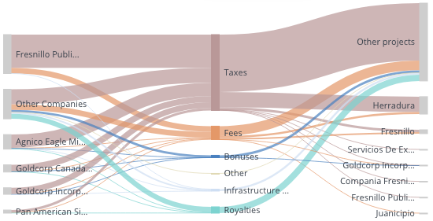
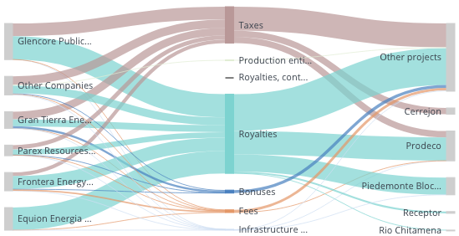
NRGI Priority Country Payment To Government Data: Latin America
Mexico
1.2 billion USD in payments
58 reporting companies
Colombia
1.8 billion USD in payments
31 reporting companies

Slide 11
NRGI Priority Country Payment To Government Data: Latin America
Mexico
1.2 billion USD in payments
58 reporting companies
Colombia
1.8 billion USD in payments
31 reporting companies

Slide 12
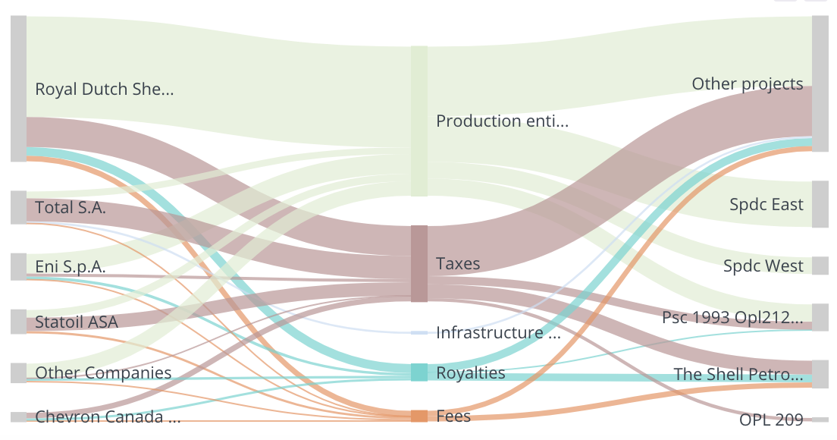
NRGI Priority Country Payment To Government Data: Asia Pacific
Mongolia
608 million USD in payments
6 reporting companies
Indonesia
8.2 billion USD in payments
24 reporting companies

Slide 13
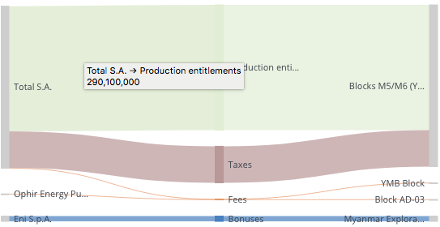
NRGI Priority Country Payment To Government Data: Asia Pacific
Myanmar
388 million USD in payments
3 reporting companies

Slide 14
How can this data be used in NRGI country programs
Capacity Development
Fiscal Regime analysis/ Revenue Management
Project-level reporting
State owned Enterprise
Private sector engagement

Slide 15
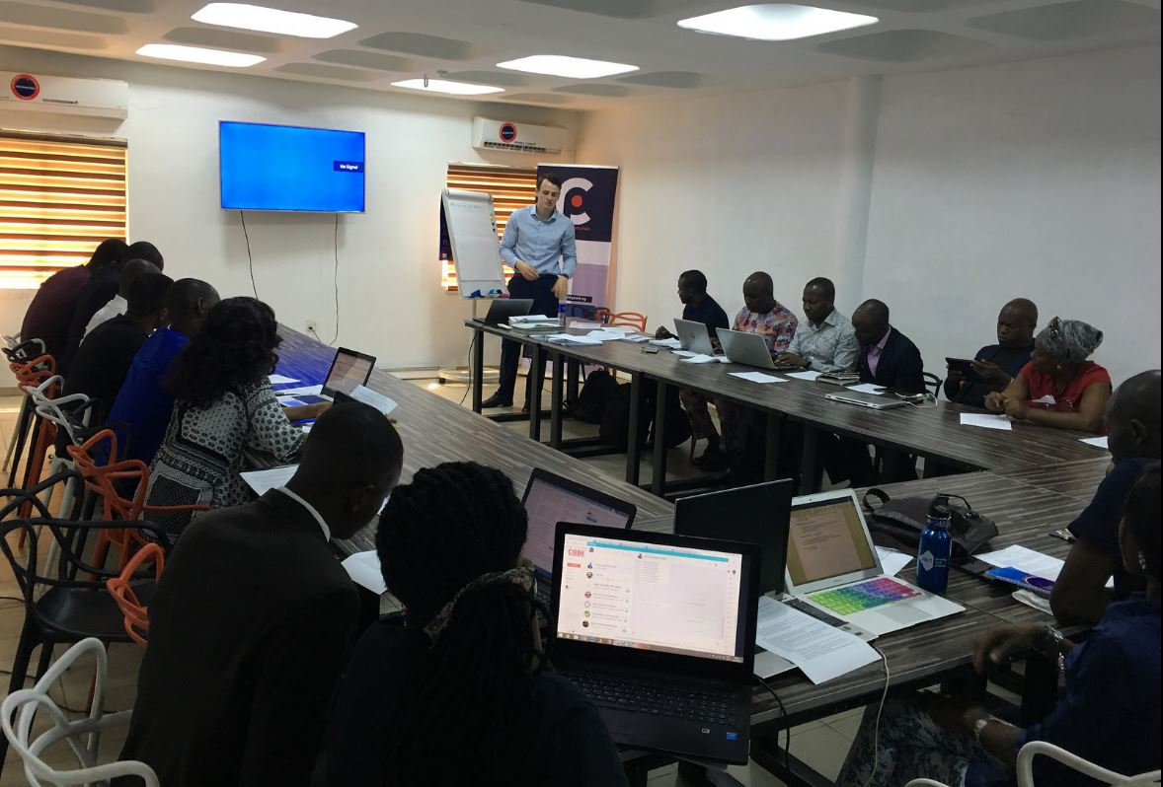

1. Capacity Development
Engage journalists, Civil society and other oversight actors on using this data as an accountability tool in country
Examples from NRGI Countries:
Civil Society:
CSO convening on Oil and Gas payments in Nigeria – Zira
Resourcebenefits.ng
BudgIT
Media engagement:
Ghana Mass Media training
Guinea - Media training
Story with Premium times on ExxonMobil lack of disclosures

Slide 16

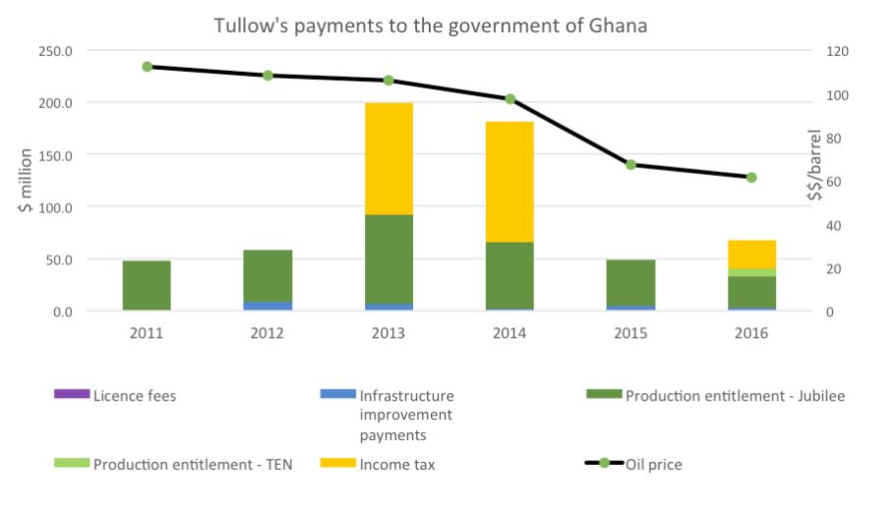
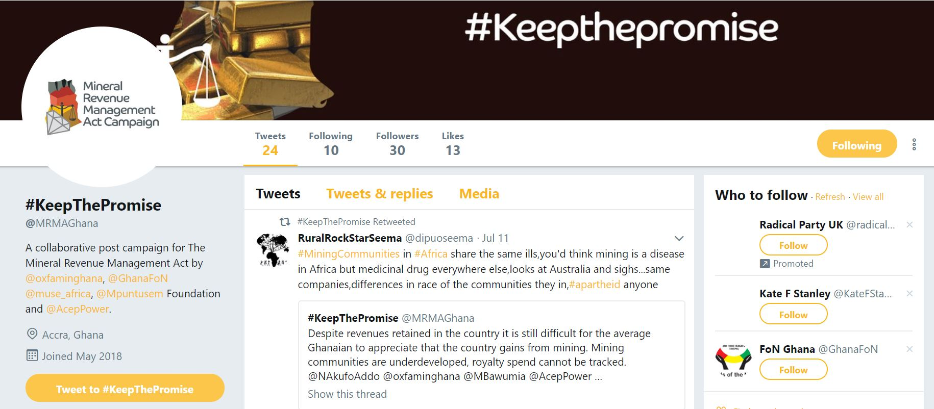
2. Fiscal Regime analysis/ Revenue Management
Provide analysis/ training on fiscal regime monitoring and revenue management issues
Examples from NRGI Countries:
Engagement with Oxfam Ghana Mineral Revenue Management Act Campaign
Ghana Fiscal regimes analysis (Tullow)
Tanzania CSO’s training
Francophone hub training

Slide 17

3. Project-level reporting
Help country entities develop their own project-level reporting practices
Demonstrate the feasibility and practicalities of project-level reporting
Engage with Government on using this company level reporting
Examples from NRGI Countries:
EITI project-level reporting technical assistance:
Presentations given to Ghana and Nigeria EITI’s on payments to governments data
Zambia EITI
Supreme Audit Institutions (SAI):
Supporting PLSI engage with the SAI in Nigeria
Government entities:
Potential technical engagement with Ghana Ministry of lands interest

Slide 18
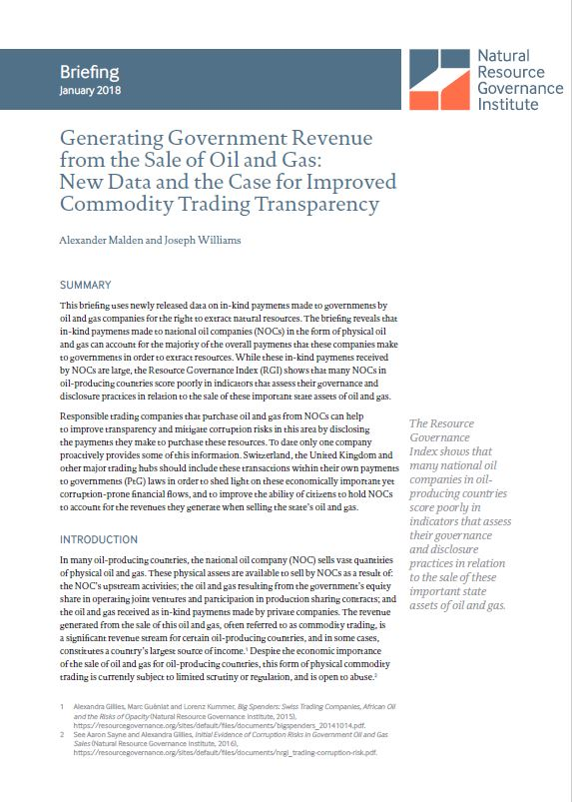
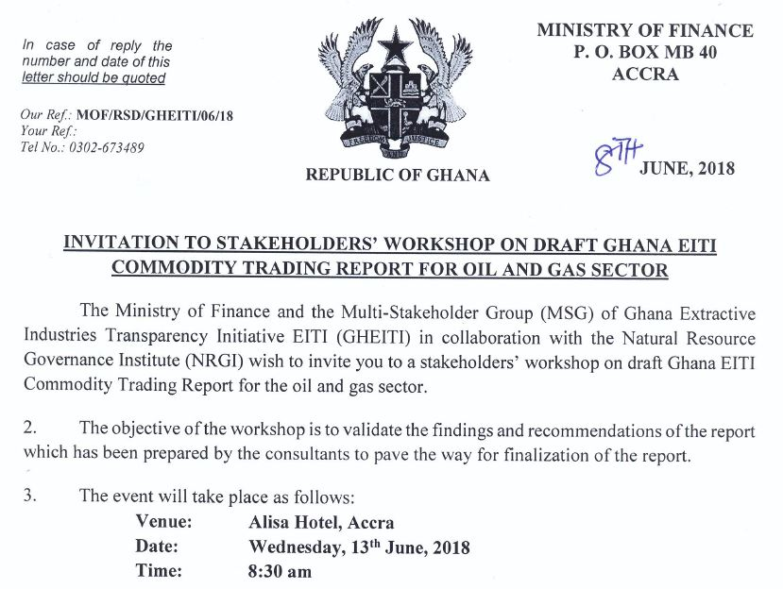
4. State owned Enterprise
Provide data/analysis on SOE governance challenges:
Importance of SOE as recipient government entity
Proliferation of in-kind payments
Examples from NRGI Countries:
‘Generating Government Revenue from the Sale of Oil and Gas: New Data and the Case for Improved Commodity Trading Transparency’ briefing
Ghana EITI Commodity Trading stakeholder workshop
Notes:
The major IOC;s operating on Jubilee, TEN and more recently Offshore Cape three points disclose there payments
Kosmos and Tullow both disclose proportionally for their equity share interest in Ten and Jubilee respectively
Unlike for the mining industry, there is already good revenue data coming from PIAC – this can be used to analyze and reconcile disclosures by the government

Slide 19
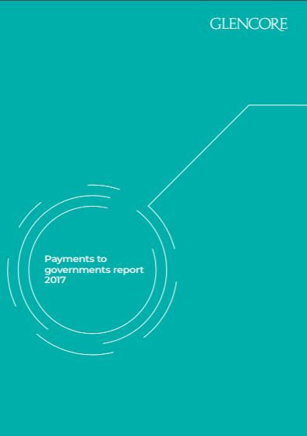

5. Private Sector engagement
Dialogue with companies on their reporting practices under these laws
Starting point to enhance private sector engagement on global and country level issues.
Examples from NRGI countries:
We have interacted with the following companies and industry forums on reporting practices:
Chevron (including on payments in Nigeria)
ENI (including on payments in Nigeria)
Glencore (including on payments in DRC)
Kosmos (including on payments in Ghana)
Shell (including on payments in Nigeria)
Other global level engagements include:
The B-Team (on tax principles)
Canada’s two largest mining associations (MAC and PDAC)
Rio Tinto; Anglo American; BP; BHP Billiton
Notes:
The major IOC;s operating on Jubilee, TEN and more recently Offshore Cape three points disclose there payments
Kosmos and Tullow both disclose proportionally for their equity share interest in Ten and Jubilee respectively
Unlike for the mining industry, there is already good revenue data coming from PIAC – this can be used to analyze and reconcile disclosures by the government

Slide 20
How can NRGI staff use this data: Resourceprojects.org tool

Slide 21
Some trends over the last year
Time for processing 1000 rows
15 days
More than 12 X increase in payment rows
15091
No. of rows of data
More than 5 X the amount of payments
$ 471 billion
Total Payment
15 X reduction in data processing time
Total Payment
The time saved has been spent on improving quality and collecting additional data to enhance its potential for use
$ 73 billion
No. of rows of data
Time for processing 1000 rows
1355
1 day
2017
2018
* This chart is not drawn to scale and is only meant for the purposes of illustration

Slide 22
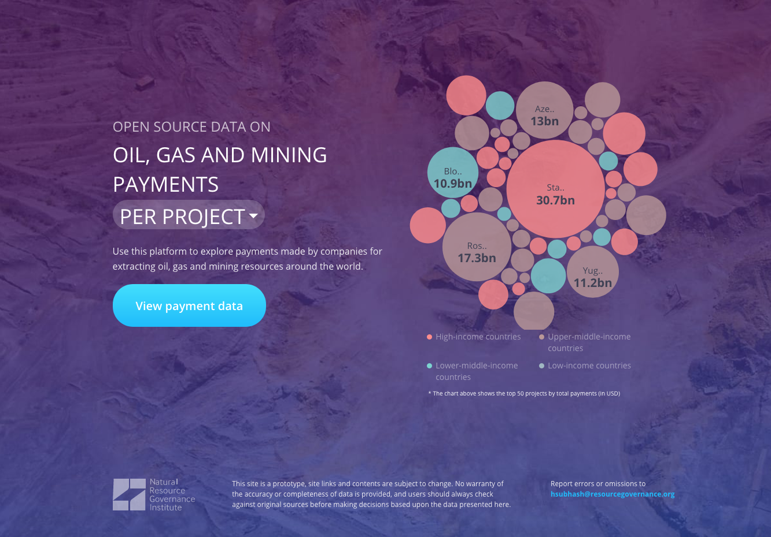
All the data in one place
471.8 billion USD in payments from 1126 reports filed by 656 companies in 18 different reporting jurisdictions.
Payments made in 154 countries to over 5000 projects and 3400 government agencies
All feature of the website are still a work in progress, so please give us feedback on how to make it better!

Slide 23
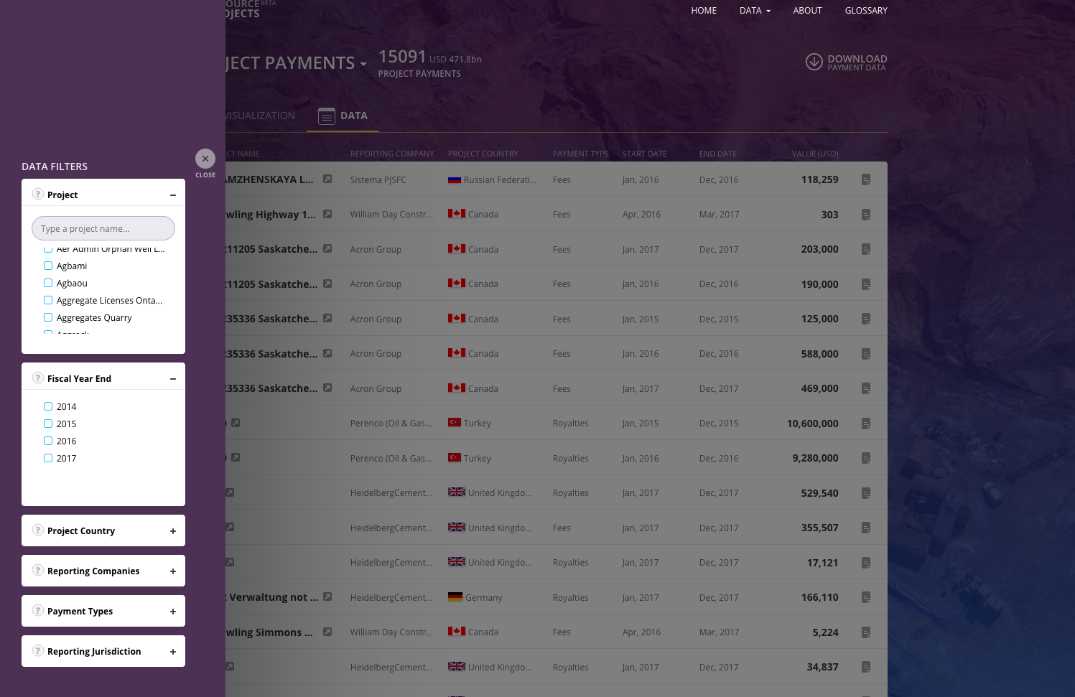
Use filters to identify data of interest
Project name
Project Country
Year
Companies
Payment types
Reporting Country

Slide 24
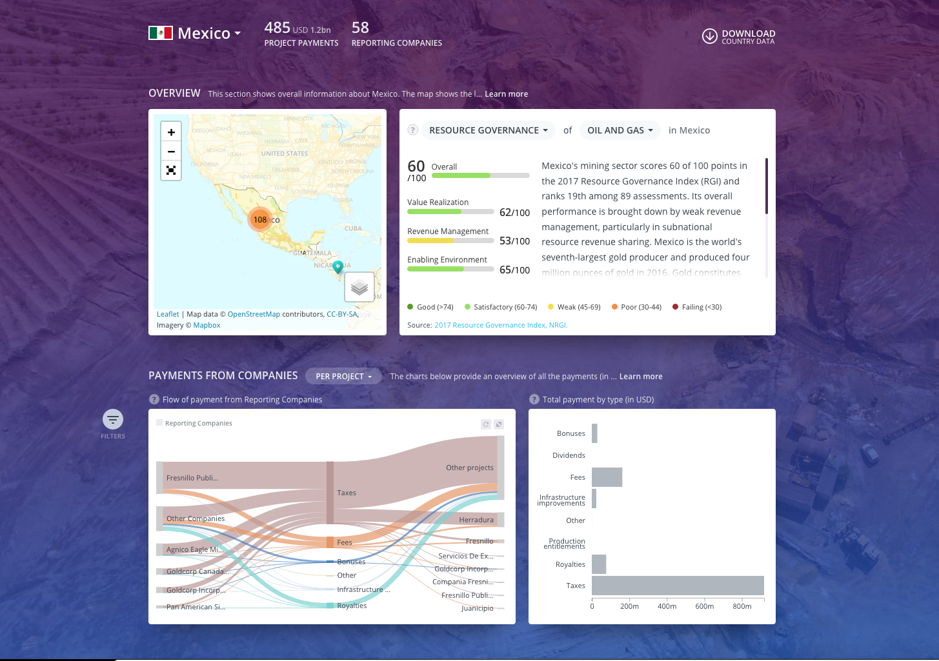
Dive deep into your country of interest
Tie other data to mandatory disclosure data
View overall payment flows to projects and government agencies
Compare your country of choice with other countries and regions

Slide 25
New Features
Use the secondary data that we have been collecting
Projects (Geocode, commodity etc.)
Govt. agencies (Geocode, level of government, hierarchy etc.)
Companies (Country of registration, location etc.)
Pages for each reporting company on the website
Summary of all reports and payments
Information on payment flows
Other features?
Better management of disclosure reports
Add new mandatory disclosure reports
Track how the data as it is being scrape, and cleaned

Slide 26
Conclusion
Payments to governments data is a new data source which can be used as part of several thematic areas to support NRGI country priorities:
Capacity Development
Fiscal Regime analysis/ Revenue Management
Project-level reporting
State Owned Enterprise
Private sector engagement
Resourceprojects.org is a unique data portal developed by NRGI which enables easy use of this data
Want to here from you on how we can make this data more accessible and useable as part of your country programs

